Slide 1
EUREKA HTIP Investment Readiness webinar #3
« Communicating with investors (post investment)»
Presented By
Selma Prodanovic | Serial Entrepreneur and Investor, « The start-up-Grande-Dame »
Michael O’Connor | Cork BIC CEO

Slide 2

European Business Angels Network
Selma Prodanovic
Fueling Europe’s Growth

Slide 3

Executive summary
Finding an angel investor
1
A business angel is …
2
A business angel brings …
3
Your “ideal” business angel
4
Finding a business angel
5
Contacting a business angel
6
Business angels invest in …
selma.prodanovic@brainswork.at

Slide 4
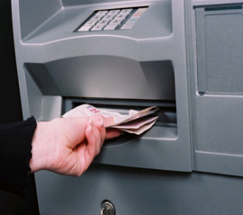
A business angel is…
A business angel is NOT a cash machine!
Simple question: would you invest in yourself?

Slide 5
A business angel brings…
Important: a business angels brings much more than just cash!
Three sorts of capital:
Financial capital (money)
Human capital (knowledge, experience)
Social capital (network)

Slide 6
Your „ideal“ business angel…
Do your homework!!
learn about the process
not every business angel is right for you!
think carefully about your needs
„picture“ an ideal business angel
do your market research & talk to your peers
identify potential business angels
contact them / meet them

Slide 7
Finding a business angel
internet & media
talk to your peers
startup events in your city
pitching events & festivals (national/international)
business angel networks in your city/country
successful entrepreneurs & CEOs in your field
people you admire
eban.org
be creative!

Slide 8
Contacting a business angel
Consider:
a „good“ business angel receives more business plans then he/she can deal with
meeting is better than mail - network
practice your pitch: be „to the point“ – fast & clear (30“ pitch)
when asked about your business always pitch – you never know who is in front of you…
know your business – you are the expert!
don‘t take it personal
be friendly – a smile open doors…
Remember: business angels are successful entrepreneurs

Slide 9
Business angels invest in…
in a very early stage
Trust & Team!!
solution of a problem
market/business potential
fun potential
their own ability to help you grow your business
TRUST is key!

Slide 10
THANK YOU!
Selma Prodanovic
selma.prodanovic@brainswork.at

Slide 11
European Business Angels Network Michael O’Connor CorkBIC
Fueling Europe’s Growth

Slide 12

Executive summary
✓
1
Situation
2
Understand the Field of Play
3
Learning to Partner
4
Golden Rules and Building Trust
5
Communicating Company and Vision - Amazon letter 1997
6
Dealing with Bad News and Cross Border Issues

Slide 13
Situation
You’ve landed the deal
Money is in the Bank
You can pay the wages and sleep better
Your team is on the Starting Platform
So what do you do?

Slide 14
Executive summary
1
Situation
✓
2
Understand the Field of Play
3
Learning to Partner
4
Golden Rules and Building Trust
5
Communicating Company and Vision - Amazon letter 1997
6
Dealing with Bad News and Cross Border Issues

Slide 15
Understand the Field of Play
Directors vs Shareholders
Your Board Composition
Role of Chairman CRITICAL
Corporate Governance Rules
Your Investor as a Partner

Slide 16
Executive summary
1
Situation
2
Understand the Field of Play
✓
3
Learning to Partner
4
Golden Rules and Building Trust
5
Communicating Company and Vision - Amazon letter 1997
6
Dealing with Bad News and Cross Border Issues

Slide 17
Learning to Partner
Understand the Mindset of the Investor
Their background, skills and interests
Being open and body language
Listening Skills
Add a social dimension – if you treat investors well new ones will join more easily

Slide 18
Executive summary
Communicating with Investors (Post Investment)
1
Situation
2
Understand the Field of Play
3
Learning to Partner
✓
4
Golden Rules and Building Trust
5
Communicating Company and Vision - Amazon letter 1997
6
Dealing with Bad News and Cross Border Issues

Slide 19
Golden Rules
Communicate early and often (informal monthly calls + formal Board Mtgs – if you talk consistently they are more willing to help)
Consistent communication encourages accountability
Aim to simplify rather inject complexity (no jargon)
Investors have a stake & want help – you can’t do everything on your own
Its about you!

Slide 20
Build Trust
Find the common ground
Be clear on commitments
Respond with clarity and energy
Always follow up
Use the phone – not always email
Use a crisis to build trust

Slide 21
Executive summary
1
Situation
2
Understand the Field of Play
3
Learning to Partner
4
Golden Rules and Building Trust
✓
5
Communicating Company and Vision - Amazon letter 1997
6
Dealing with Bad News and Cross Border Issues

Slide 22
Communicating Company & Vision
Find the right investors
Be the leader of the Team
Articulate the Strategy and journey
Be clear on what you are doing
Use numbers to show metrics

Slide 23
An example of clarity to build trust

Slide 24
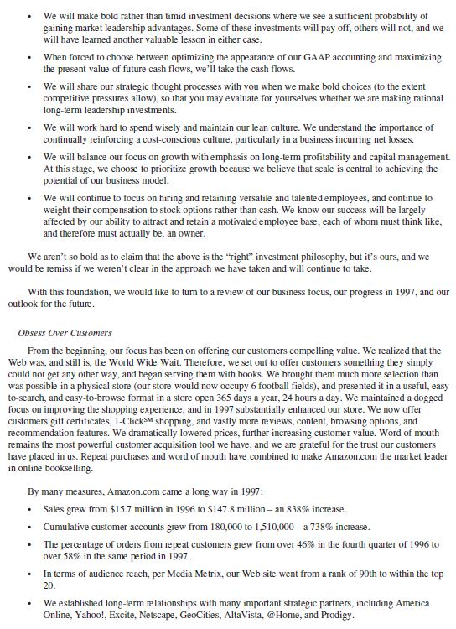

Slide 25
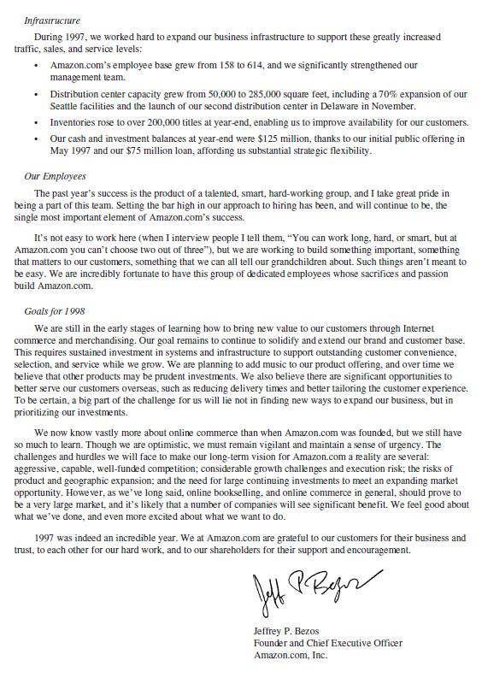

Slide 26
Executive summary
1
Situation
2
Understand the Field of Play
3
Learning to Partner
4
Golden Rules and Building Trust
5
Communicating Company and Vision - Amazon letter 1997
✓
6
Dealing with Bad News and Cross Border Issues

Slide 27
Dealing with Bad News
Advance grooming of the risk & timing
Joint decision making
News out quickly – no excuses but opportunities
Risk limitation to limit cost
No surprises!

Slide 28
Cross Border Issues
Different cultures react differently
Care with Board and Investor coalitions
Be slow and clear with language
Do not isolate a minority
Try to meet if possible (personal contact = trust)

Slide 29
Managing your Investors is as important as managing your Executive team
Thank You
www.corkbic.com
Michael O’Connor

Slide 30

Questions and Answers

Slide 31
Next E! HTIP events
Venture Academy Utrecht
  17th of April 2015
Venture Academy Copenhagen
  21st of April 2015

